Slide 1
Water cycle and Weather
By Savannah Ramer

Slide 2
The Water Cycle
Evaporation – heat from the sun causes water to rise from oceans, lakes, and rivers and become water vapor.
Condensation – as the water vapor rises it cools and condenses into water droplets that form clouds.
Precipitation – water droplets become heavy and fall back to the Earth.

Slide 3
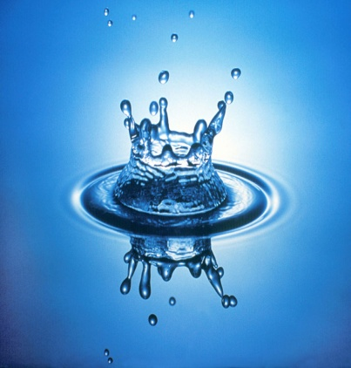
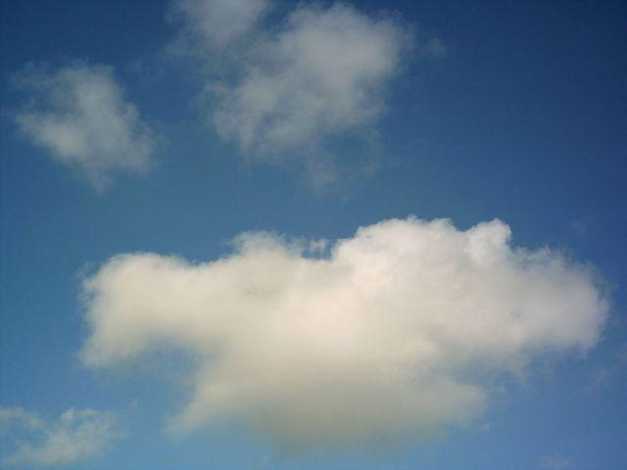
Solids, Liquids, and Gases
Solids – of definite shape and volume. Some examples are ice, wood, and glass.
Liquids – substances that can flow. Some examples are water, tea, and oil.
Gases – substances that have no definite shape and can expand to fill any container. Some examples are water vapor, oxygen, and helium.

Slide 4
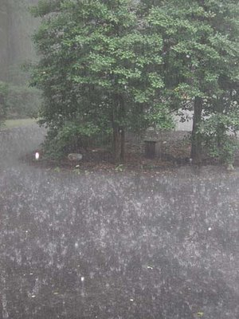
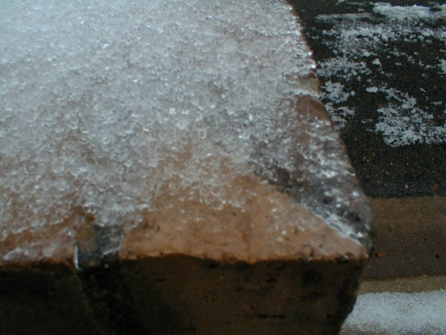
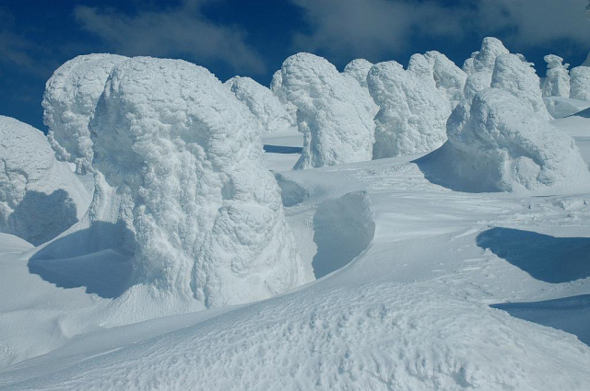
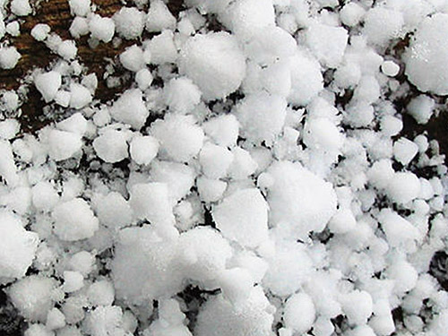
Forms of Precipitation
Rain
Snow
Sleet
Hail

Slide 5
The Formation of Clouds
Clouds form when water vapor rises, cools, and condenses into water droplets.

Slide 6
Stratus Cloud
Stratus Cloud – low-level clouds that form in layers and usually bring rain.

Slide 7
Cumulus Cloud
Cumulus Cloud – fluffy clouds that are flat at the bottom, form low in the sky, and usually mean fair weather.

Slide 8
Cirrus Cloud
Cirrus Cloud – thin clouds that look like feathers, are made of ice crystals, form high in the sky, and mean fair weather.

Slide 9
Cumulonimbus Cloud
Cumulonimbus Cloud – clouds that bring thunderstorms.

Slide 10
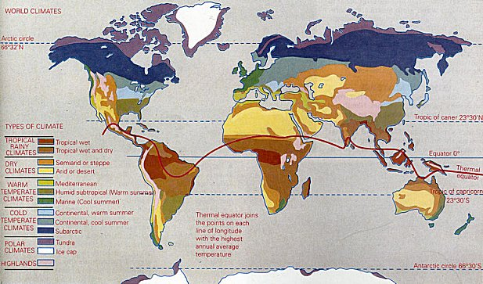
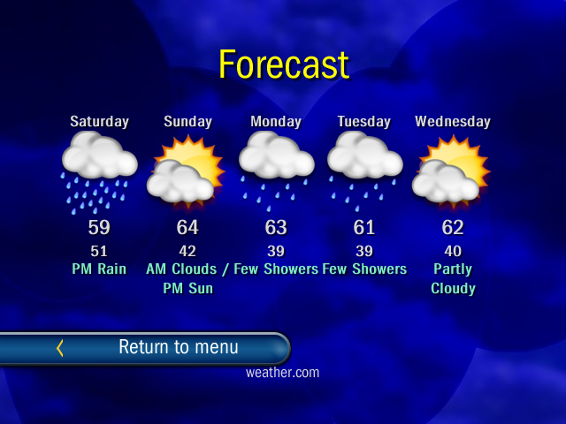
Climate and Weather
Climate
Weather
It is the average weather conditions in an area over a long period of time.
It is conditions of the atmosphere at a certain place and time.

Slide 11
Thermometer
Thermometer – measures the temperature of the air.

Slide 12
Rain Gauge
Rain Gauge – collects and measures the amount of precipitation that has fallen in an area.

Slide 13
Barometer
Barometer – measures air pressure.

Slide 14
Wind Vane
Wind vane – measures wind direction.

Slide 15
Anemometer
Anemometer – measures the speed of the wind.

Slide 16
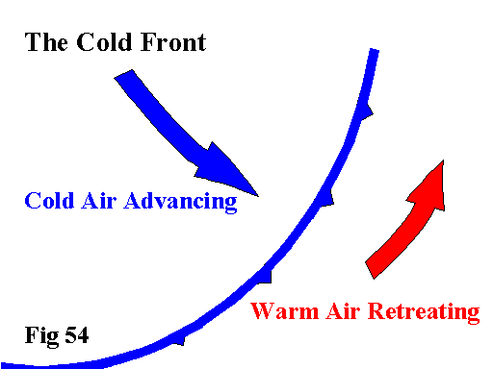
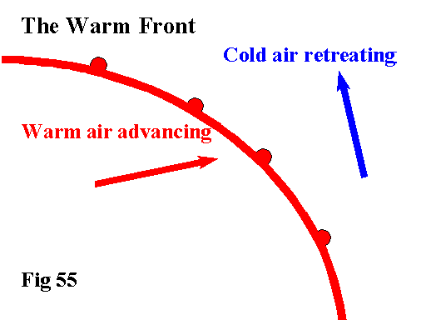
Cold Front and Warm Front
Cold Front
Warm Front
Cold Front – forms as a cold air mass meets a warm air mass and the cold air pushes the warm air up; thunderstorms often happen along a cold front.
Warm Front – forms as a warm air mass pushes into a cold air mass and the warm air moves slowly over the cold air; steady precipitation often happens along a warm front.

Slide 17
What I Learned
I learned about different types of clouds and the kind of weather they bring. I also learned about the different types of precipitation and the tools that measure weather conditions. My favorite part of the unit was learning about the water cycle.

