Slide 1
Water cycle and weather
BY: KENDALL GREENE.

Slide 2
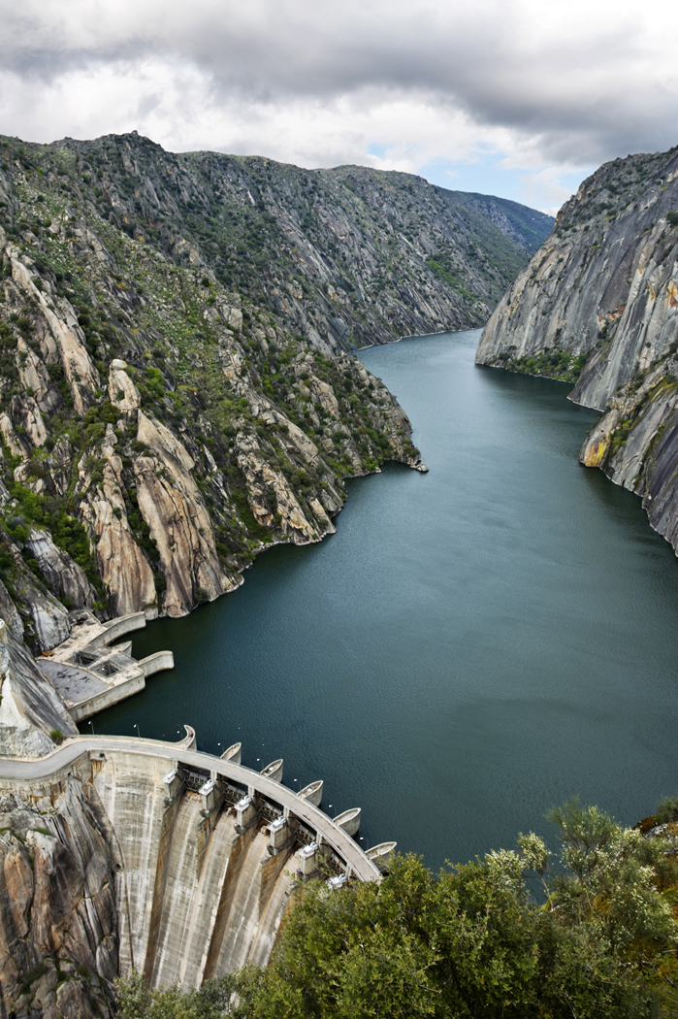
Water cycle
- The water cycle is the movement of water into the air as water vapor and back to earth’s surface as precipitation.

Slide 3
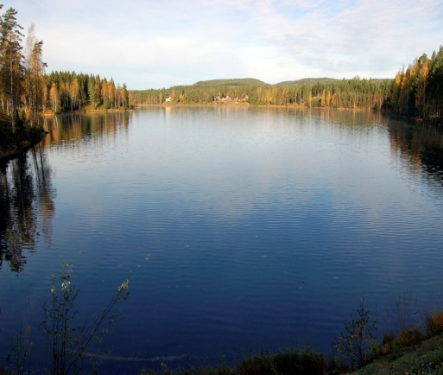
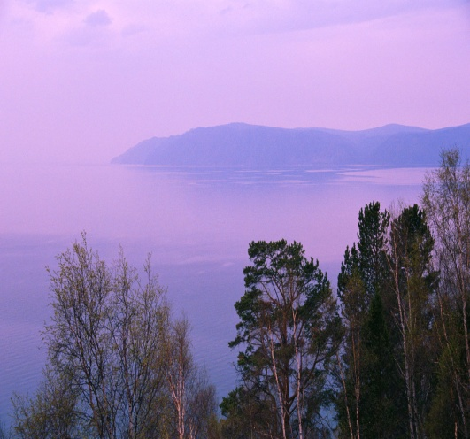
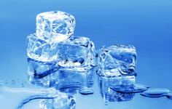
Solids, liquids, gasses
Solids- matter that stays in place and cannot move freely. (ice, blocks, computers, books)
Liquids-matter that moves freely. (water, juice, milk)
Gases- matter that moves freely and separates to fill every available area. (water vapor, oxygen, fog)

Slide 4
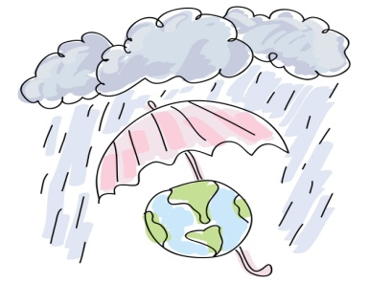


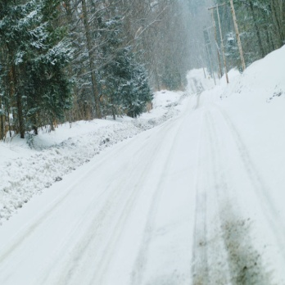
Precipitation
1- rain
2-sleet
3-hail
4-snow

Slide 5
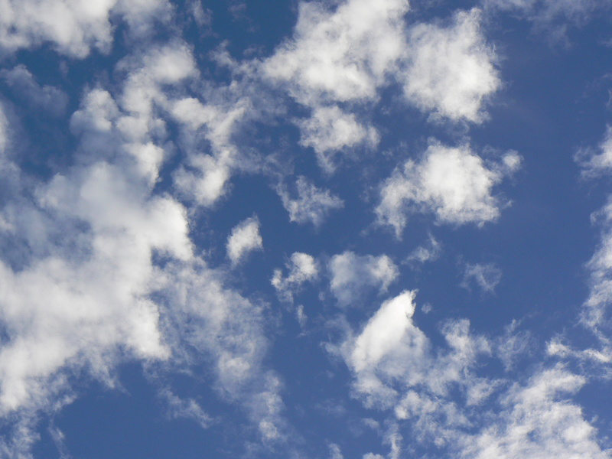
clouds
What forms clouds?
Clouds are formed when evaporation happens. Water comes from lakes and goes up and forms clouds.

Slide 6

status
Status clouds are low – level clouds that form in layers and usually bring rain.

Slide 7
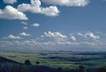
cumulus
Cumulus clouds are fluffy and are flat at the bottom they usually bring fair weather.

Slide 8
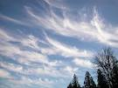
cirrus
Cirrus clouds are thin clouds that look like feathers and usually bring fair weather.

Slide 9

Cumulonimbus
Cumulonimbus clouds usually bring thunderstorms.

Slide 10

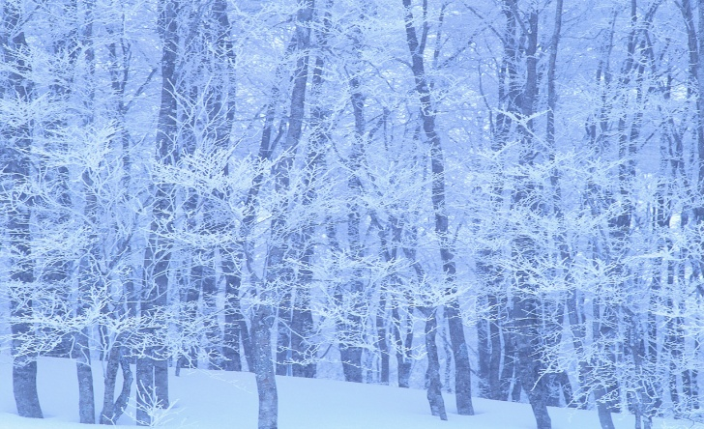
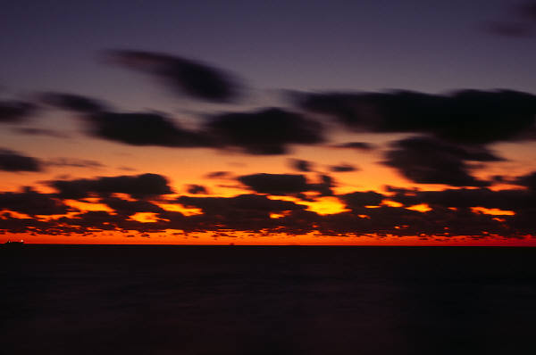
Climate VS. weather
Weather- the conditions of the atmosphere at a certain place and time.
Climate- the average weather conditions in a area over a long period of time.

Slide 11
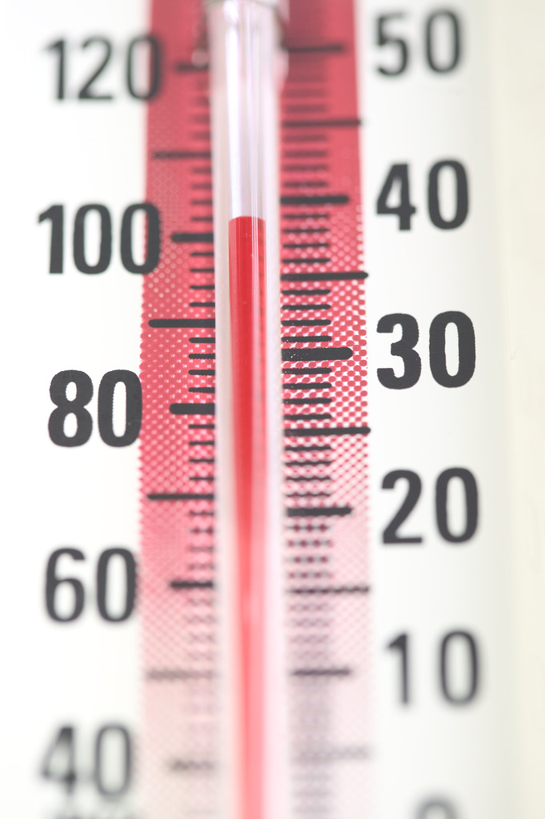
Thermometer
Thermometer- measures the temperature of the air.

Slide 12
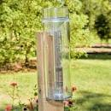
Rain gauge
Rain gauge-measures the amount of precipitation that has fallen in an area.

Slide 13
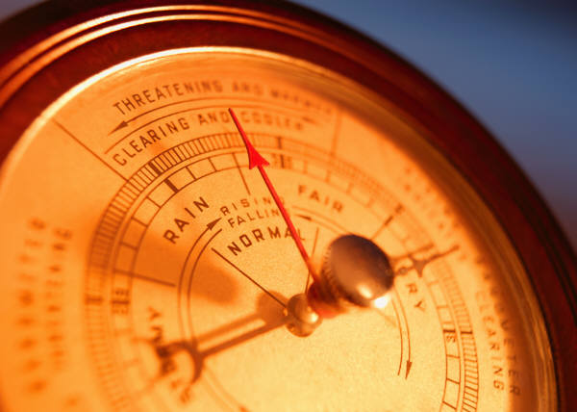
barometer
Barometer-measures air pressure.

Slide 14

Wind vane
Wind vane- Tells you the direction of the wind.

Slide 15
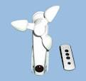
anemometer
Anemometer- a device for measuring wind speed.

Slide 16
Cold and warm fronts
Cold front- a cold front is clod air moving towards warm air. It usually brings thunderstorms.
Warm front- a warm front is warm air moving towards cold air. Fog is usually present after a warm front moves in.
They both will bring a change in weather and wind shifts.

Slide 17
My favorite part
My favorite part is when we learned about how the water cycle works and the different kinds of precipitation.

