Slide 1
The Water Cycle and Weather
By :Kelly Tanner

Slide 2
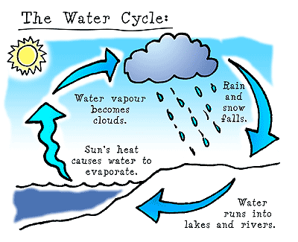
The process of the Water Cycle
The Water Cycle is the water on Earth changing from one form to another over and over.
The runoff evaporates into water vapor .Then the water vapor cools and condenses into condensation and either falls as rain, snow , hail, or sleet which is precipitation . Finally process starts all over again.

Slide 3
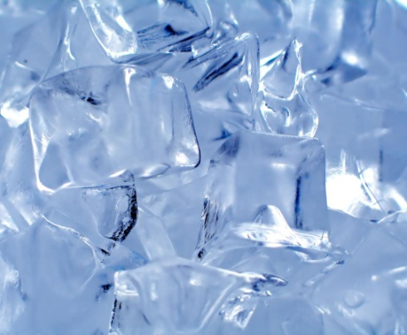
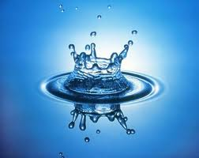
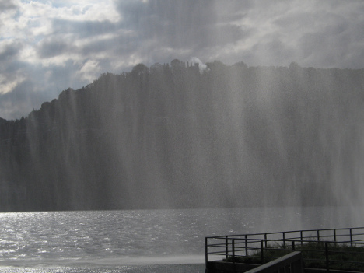
Solids, Liquids, and Gases
Water can be a solid, liquid, or a gas.
A solid is something hard and forms when heat is removed from a liquid like ice.
A liquid is something that is wet and flows like water.
A gas is something you can’t see and forms when heat is added to liquid like water vapor.

Slide 4
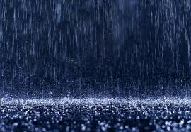
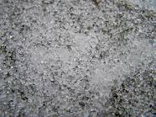
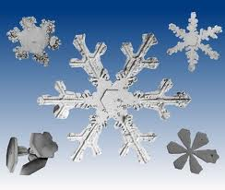
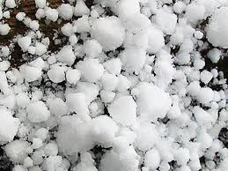
4 Forms of Precipitation
Rain Sleet
Snow
Hail

Slide 5
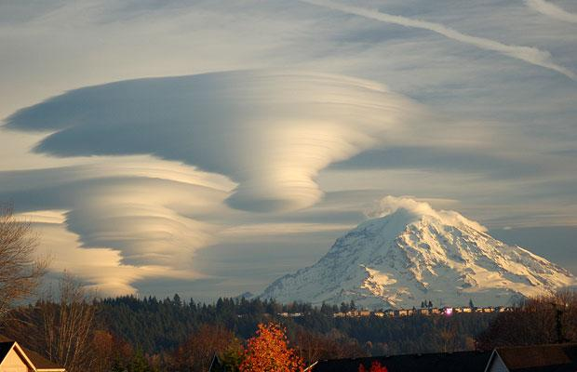
The Formation of Clouds
When water vapor rises, it cools and condenses into water droplets. A large collection of water droplets form clouds.

Slide 6
Stratus Clouds
Clouds that form at a low level in the sky.
They form in layers.
They usually bring rain.
They are grey.

Slide 7
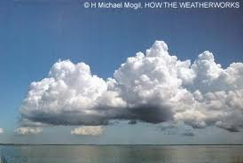
Cumulus Clouds
Clouds that are fluffy and have flat bases.
They form low in the sky.
They indicate fair weather.

Slide 8
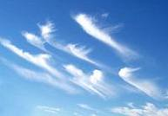
Cirrus Clouds
Clouds that are thin and look like feathers.
They are made of ice crystals.
They are high in the sky.
They indicate fair weather.

Slide 9
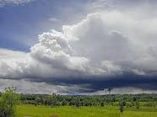
Cumulonimbus Clouds
Clouds that bring thunderstorms.

Slide 10
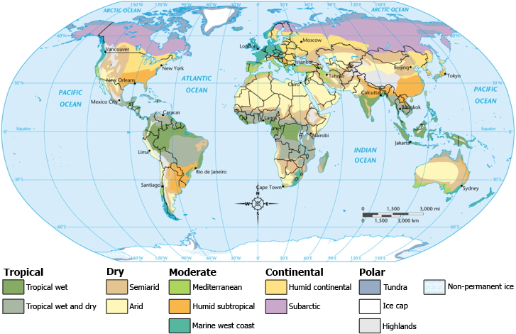
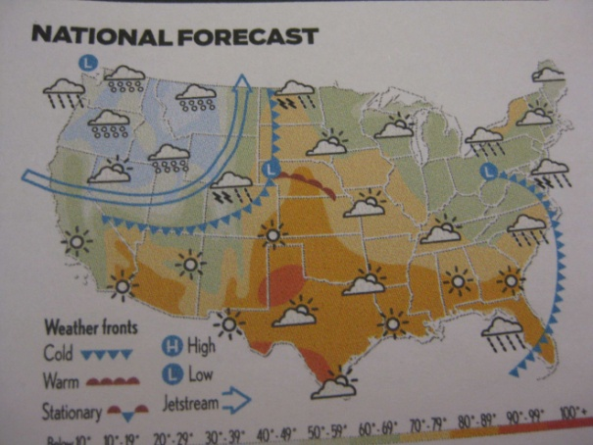
Difference Between:
Climate
Weather
The weather conditions in one place over time.
It’s different in different areas of the world.
Climate is described.
The conditions of the atmosphere at a certain time and place.
All areas of the world can have the same weather.
Weather is measured.

Slide 11
Thermometer
Measures the temperature of the air

Slide 12
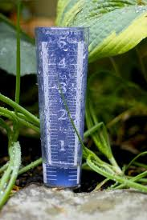
Rain Gauge
Collects and measures rain fall.

Slide 13
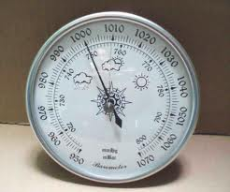
Barometer
Measures air pressure.

Slide 14
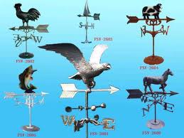
Wind Vane
Measures wind direction.

Slide 15
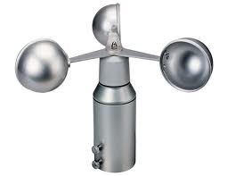
Anemometer
Measures wind speed.

Slide 16
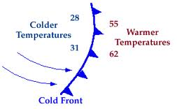
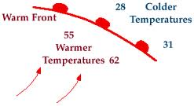
Difference Between:
Cold Front
Warm Front
Forms when a cold air mass meets a warm air mass.
Cold air moves under warm air and pushes it up.
Types of weather:
Thunderstorms, tornadoes, and precipitation
Forms when a warm air mass pushes into a cold air mass.
Warm air slowly moves up over cold air.
Types of weather:
Steady precipitation

Slide 17
Summary
I learned about weather, what makes up air, and clouds.
I learned how to define solids, liquids, and gases.
I also learned what a barometer, thermometer anemometer, wind vane, and a rain gauge measures.
My favorite part in this unit was when the class learned what the different clouds are ,how to identify them, and what they do.

Slide 18
Sources
I used my Science workbook.
I used my Science journal.
I used my brain.
I used Google.

