Slide 1
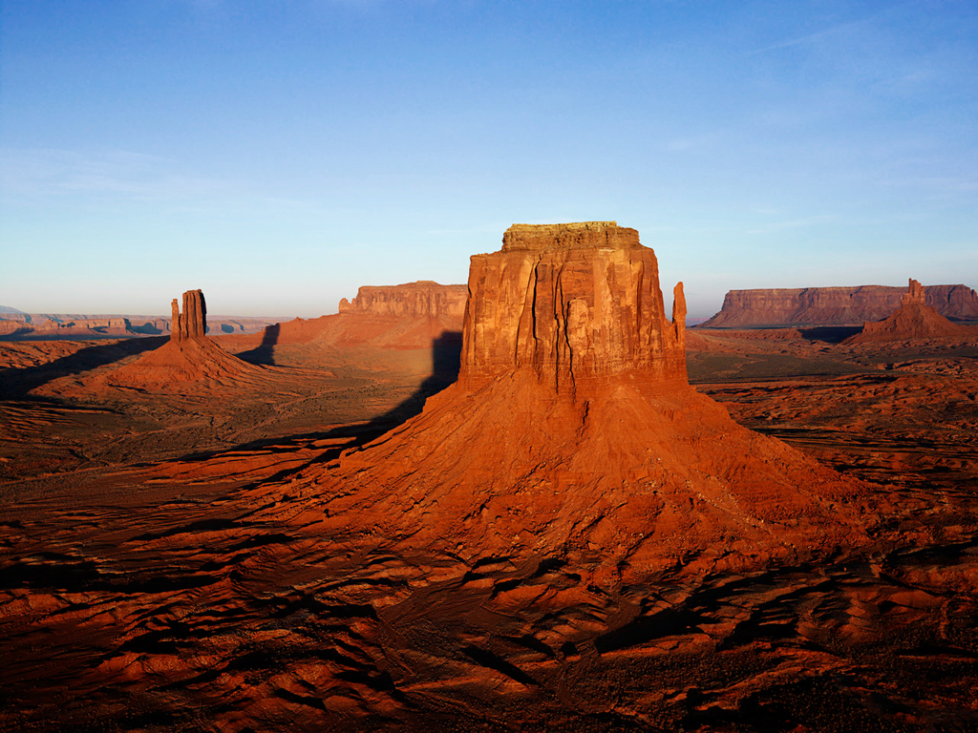
ECOSYSTEMS
Kendall Greene

Slide 2
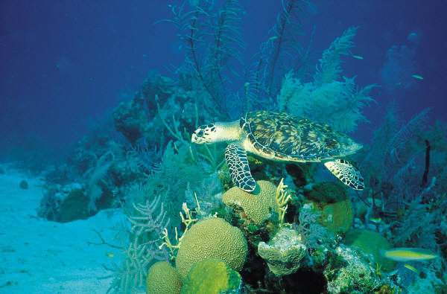
Description of an ecosystem
-A complex set of relationships that include all living, non-living things, and their habitats.
-They are all different
-Self producing when healthy
-Can have a variety of plants and animals.

Slide 3
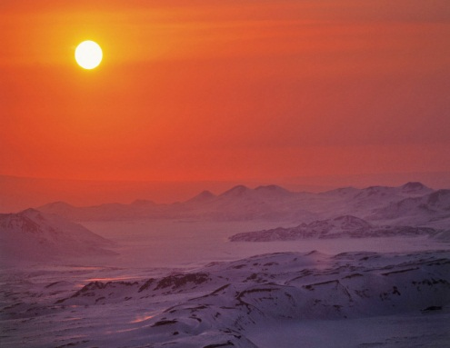
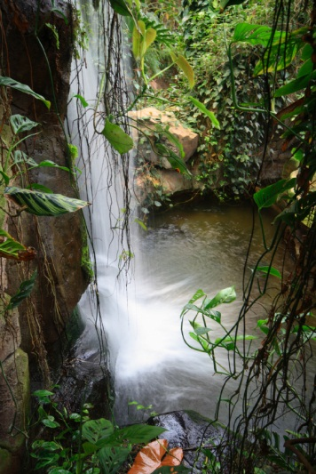
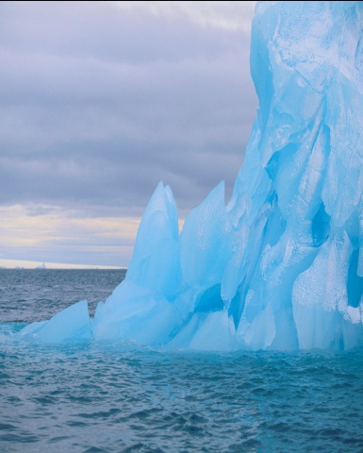
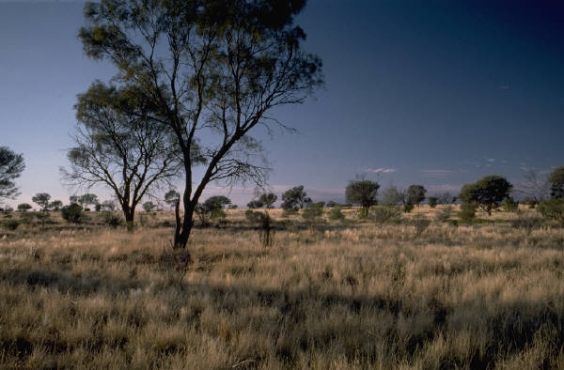
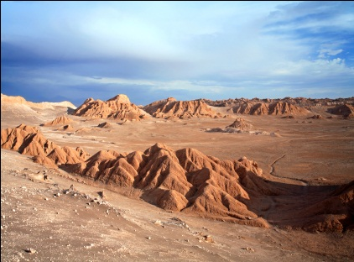
Types of ecosystems
Tropical rainforest
Desert
Ice caps
Tundra
Mid-latitude grasslands

Slide 4

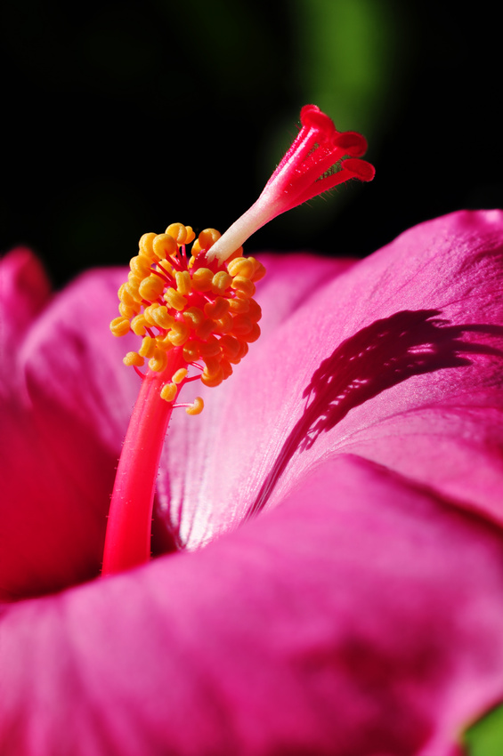
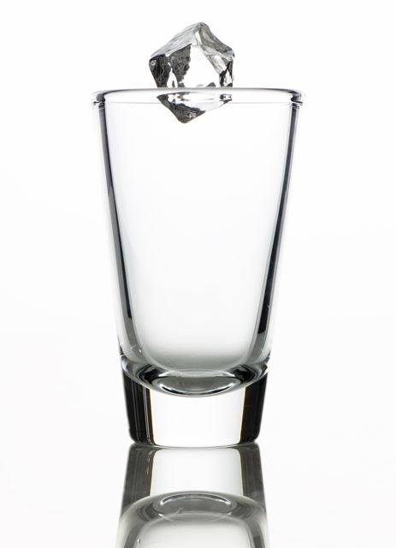
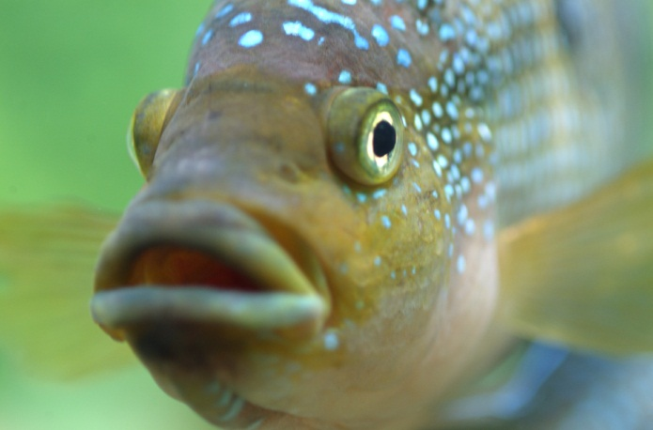
Living vs. non-living
Living-requires air, water, soil, or light.
Non-living-does not require these things.
Vs.

Slide 5
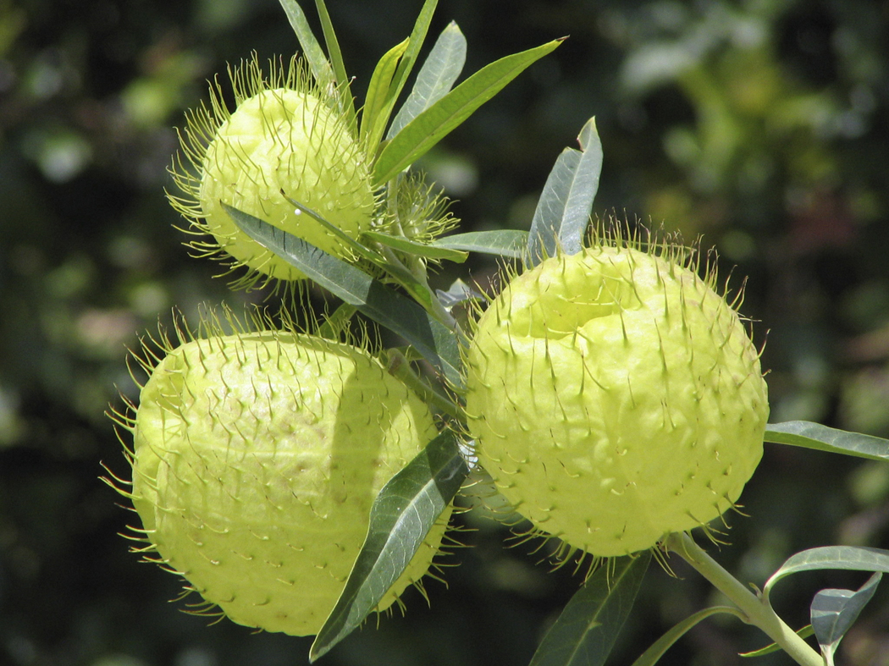
producers
Any organism that makes it’s own food.

Slide 6
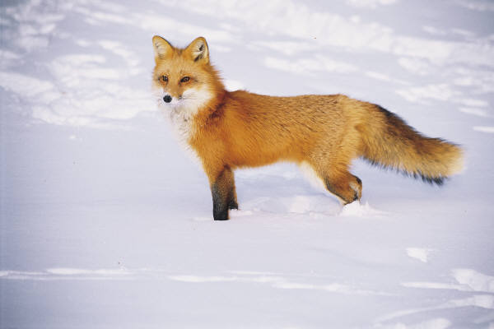
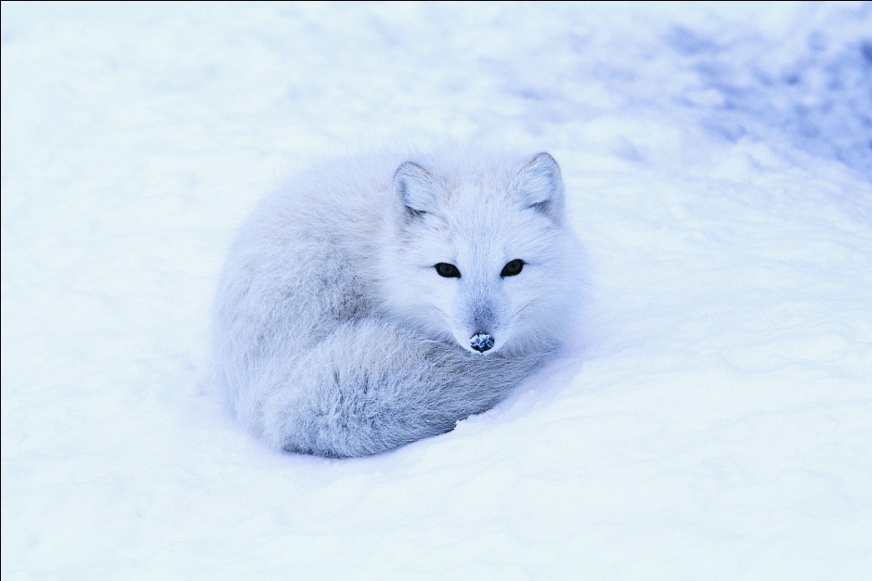
consumers
An organism that eats other living things to get energy

Slide 7
decomposers
An organism that breaks down the remains of dead organisms.

Slide 8
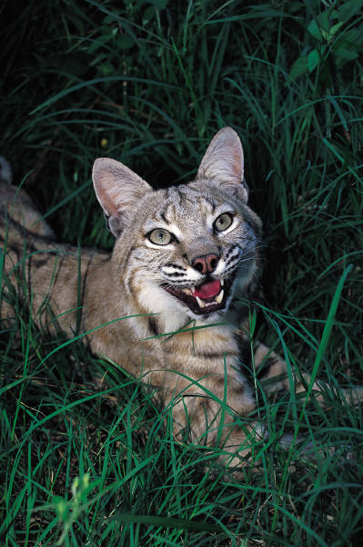
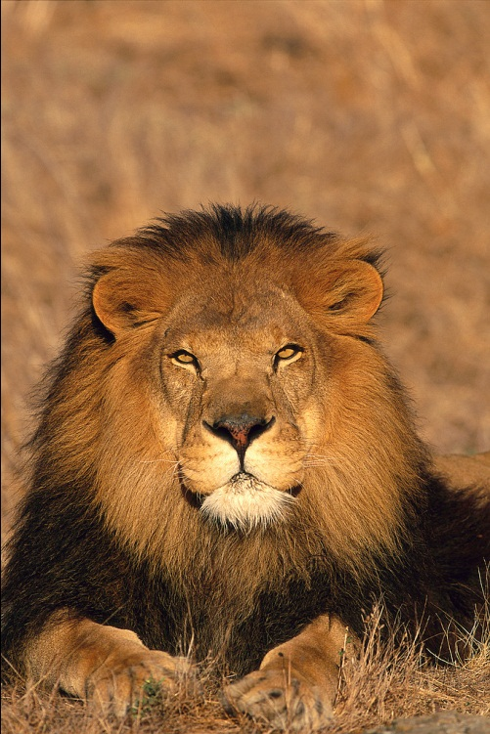
carnivores
An animal that only eats other animals.

Slide 9
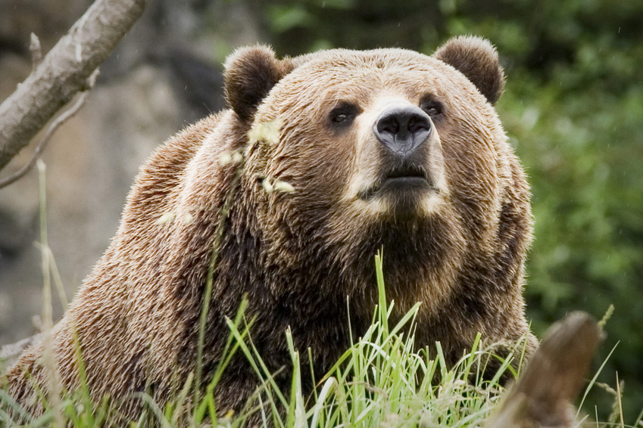
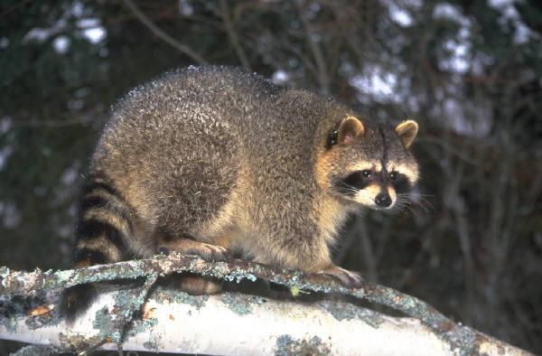
omnivore
An animal that eats both plants and animals.

Slide 10
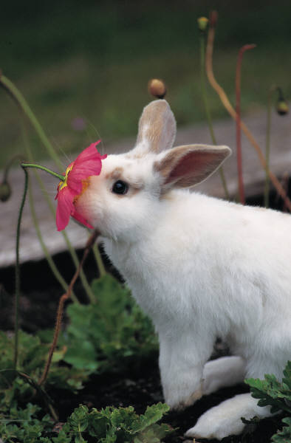
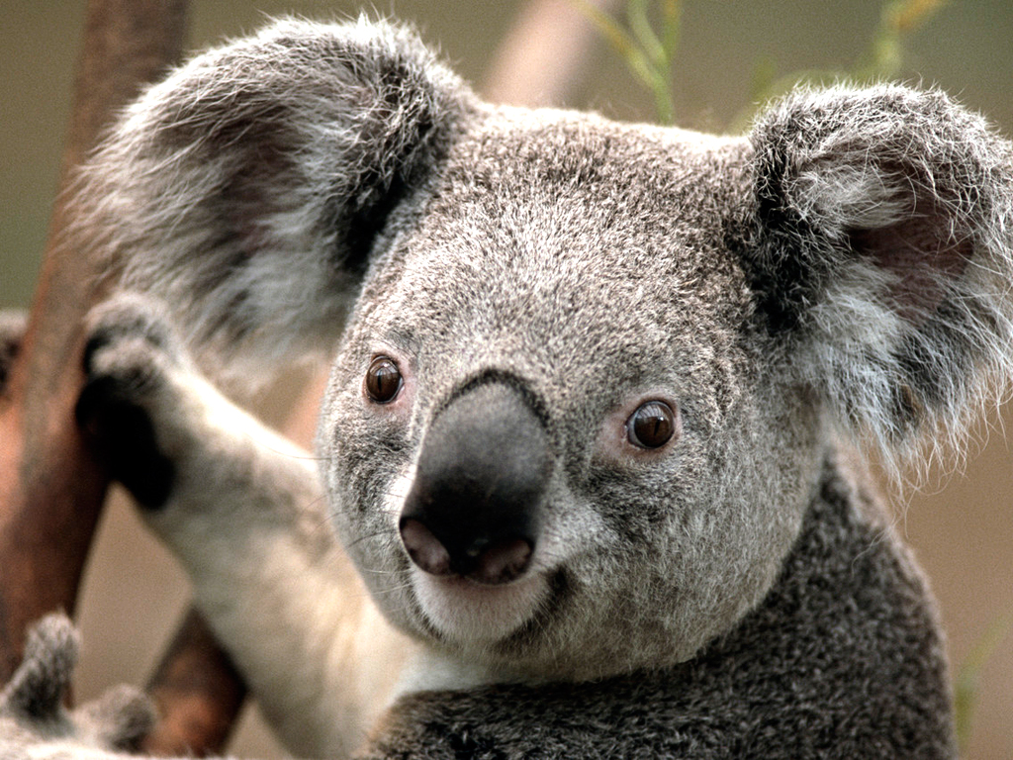
herbivore
An animal that only eats plants.

Slide 11
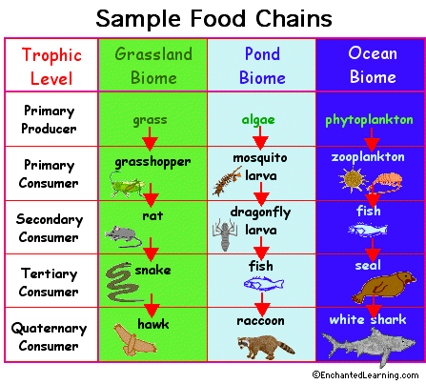
Examples of a food chain
grass<rabbit<snake<fox
Algae<fish<bear<person
Here are some more examples

Slide 12
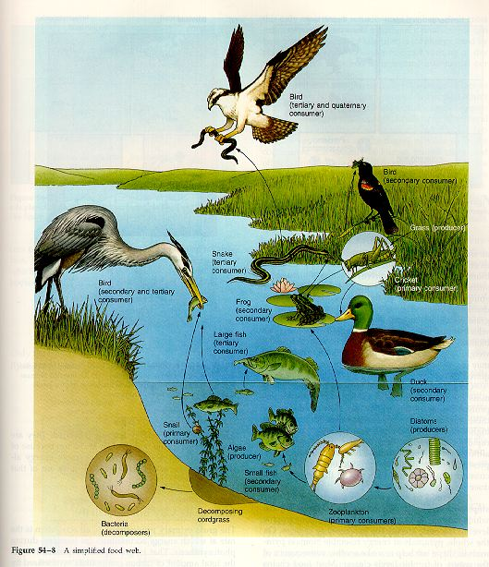
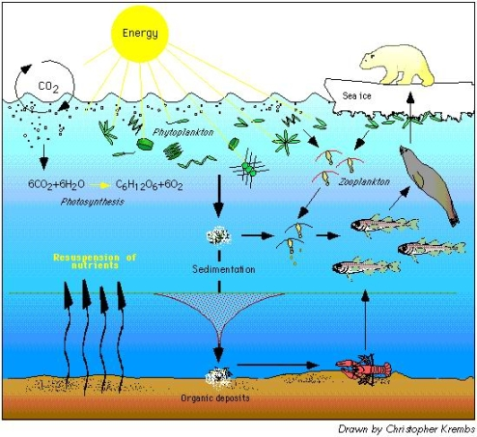
Examples of food web
When two food chains overlap

Slide 13
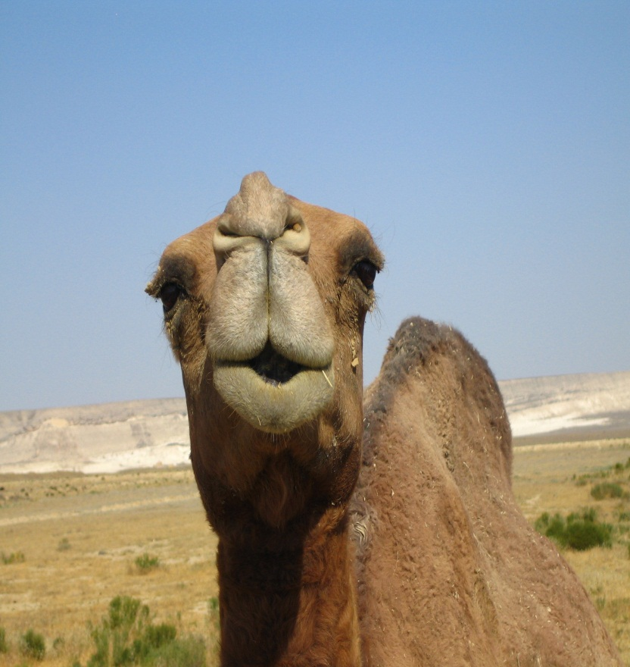
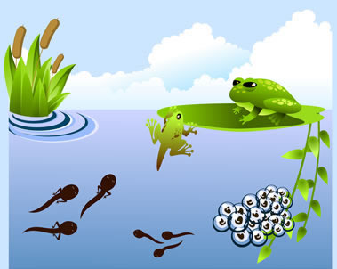
Organisms adapt for survival
Camels have adapted to living in dry desert heat by being able to store water for long periods of time
Tadpoles loose tails and grow legs becoming frogs allowing them to adapt to life on land.

Slide 14
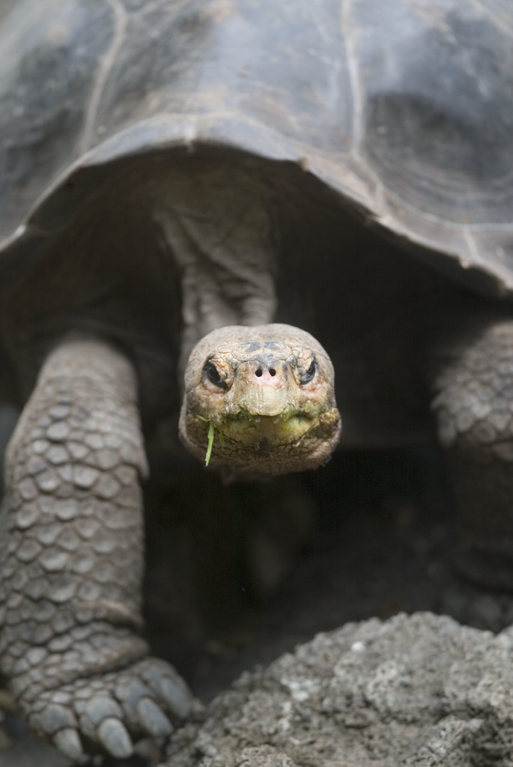
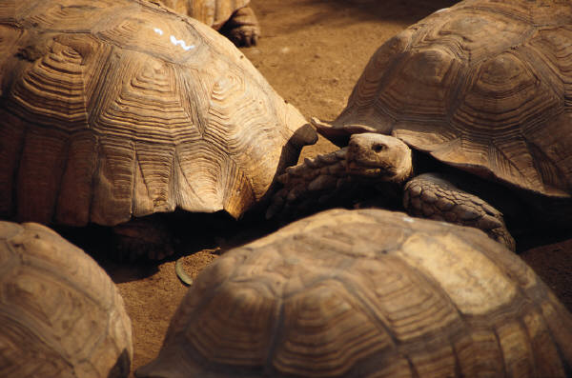
My favorite part
My favorite part was when we learned about food webs and how they overlap.

