Slide 1
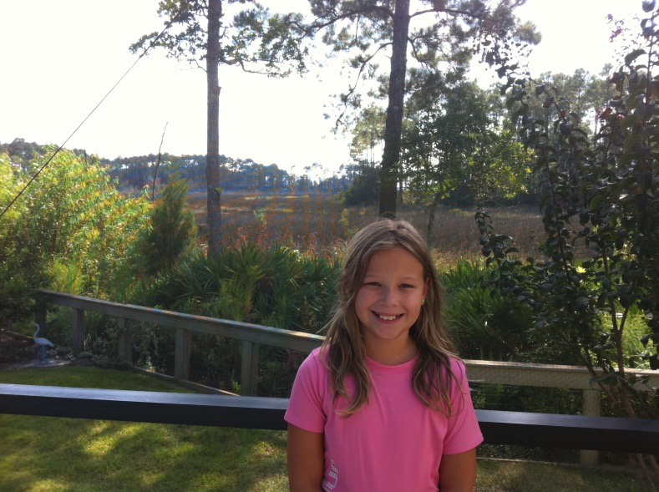
Ecosystem!
By Kaitlyn Muth
Ms. Tabor’s Class
September 2011

Slide 2
Ecosystem An Ecosystem is where living and non-living things interact.

Slide 3
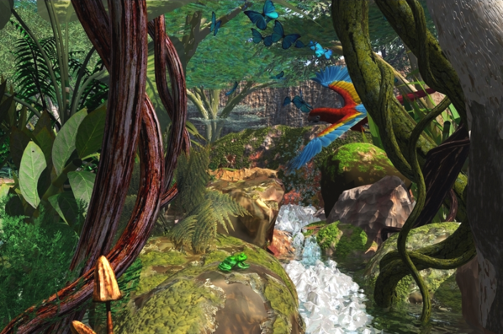
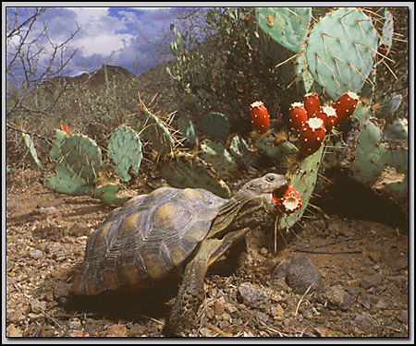
Different Ecosystems There are many different types of ecosystems.
Desert
Polar
Rainforest

Slide 4
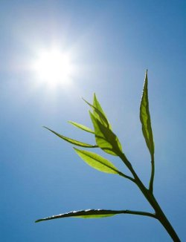
Producers!
Producers are organisms that make their own food. Flowers are producers.

Slide 5
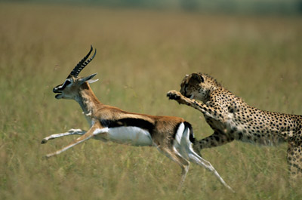
Consumers!
Organisms that eats other living things for energy are consumers.

Slide 6
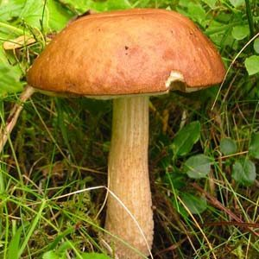
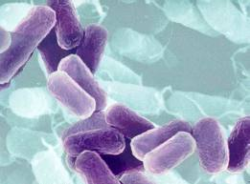
Decomposers!
A decomposer is an organism that breaks down dead organisms. Examples: worms, fungi. They recycle energy that other organisms can use to live. Some are microorganisms. Example: bacteria.

Slide 7
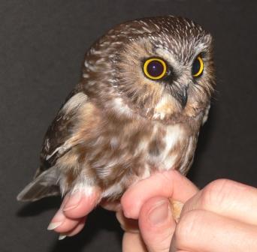
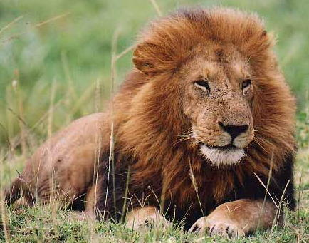
Carnivore!
A carnivore is a consumer that only eats other animals. Example: lion, owl.

Slide 8
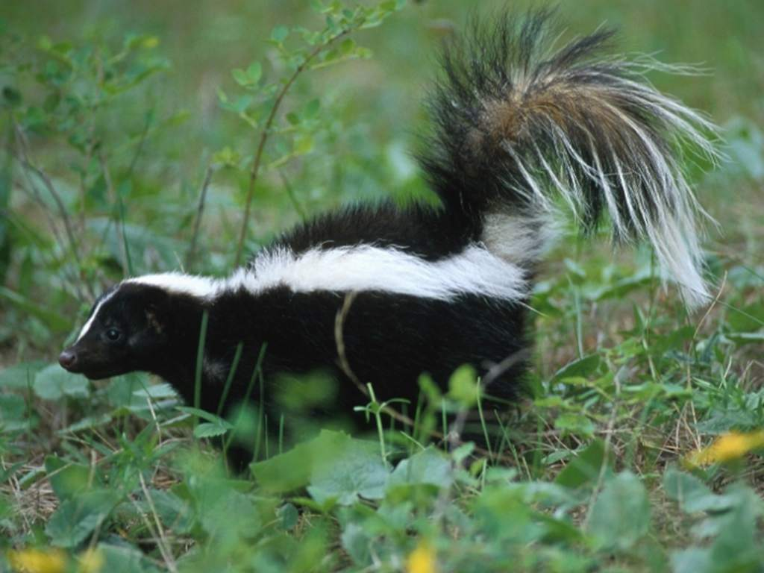
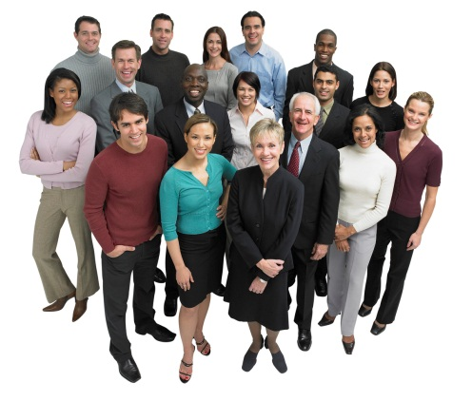
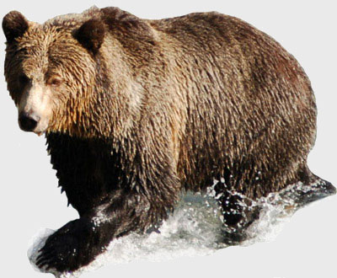
Omnivore!
Omnivores are consumers that eat plants and animals. Example: bears, skunks, and people.

Slide 9
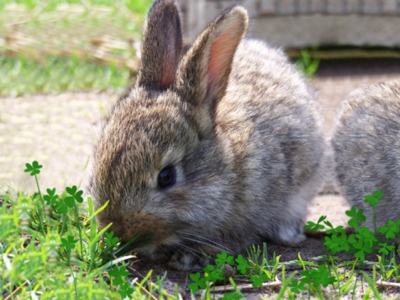
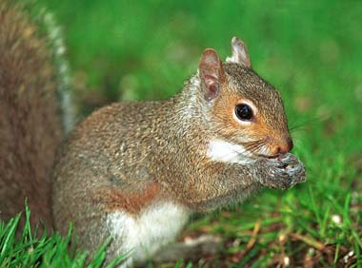
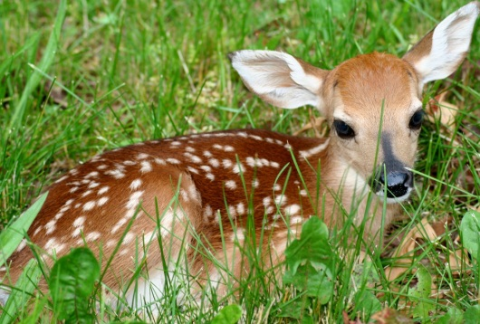
Herbivore!
Herbivores are consumers that only eat plants, no meat. Example: rabbit, deer, and squirrel.

Slide 10
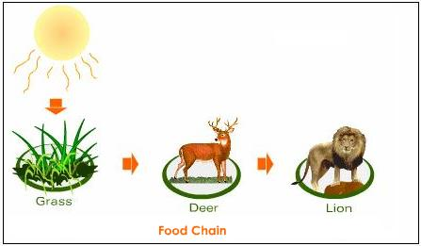
Example of a food chain!
A food chain shows the path of food energy in the ecosystem.

Slide 11
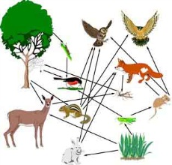
Example of a food web!
A food web shows how two or more food chains overlap. It shows how a plant or animal is part of another food chain.

Slide 12
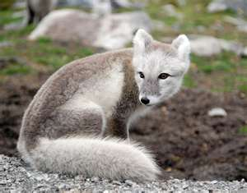
How organisms adapt for survival!
Both plants and animals adapt to their habitat to survive. The adaptation can be:
Physical
The Arctic fox uses its coat to stay worm and hunt because of its camouflage
Behavior
Bunnies run in a zig-zag pattern to confuse the predator

Slide 13
Summary, favorite part!
An ecosystem is where living and non-living things interact with each other. In an ecosystem there are producers, consumers, and decomposers. There are three types of consumers and they are carnivore, omnivore, and herbivore. A food web is where two or more food chains overlap. Organisms survive using physical and behavior adaptations.
My favorite part is how organisms survive. I like it because if they don’t survive we won’t have food and we will die. We are part of the food web too!

