Slide 1
ECOSYSTEMS
Dalton Cone
4th Grade
August 28, 2011

Slide 2
Agenda
Description of an ecosystem
Examples of different ecosystems
Difference between living and nonliving things
Producers
Consumers
Decomposers
Carnivore
Omnivore
Herbivore
Example of a food chain
Example of a food web
Examples of how organisms adapt for survival
Summary of what you have learned, including your favorite part(s) of this unit.

Slide 3
Ecosystem
An ecosystem is all living and nonliving things that exist and interact in one place.

Slide 4
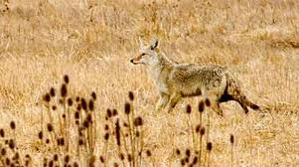
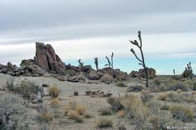
Different Ecosystems
Polar
Prairie
Desert

Slide 5
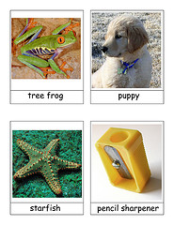
Difference between living and nonliving things
Living things need nonliving things to survive.

Slide 6
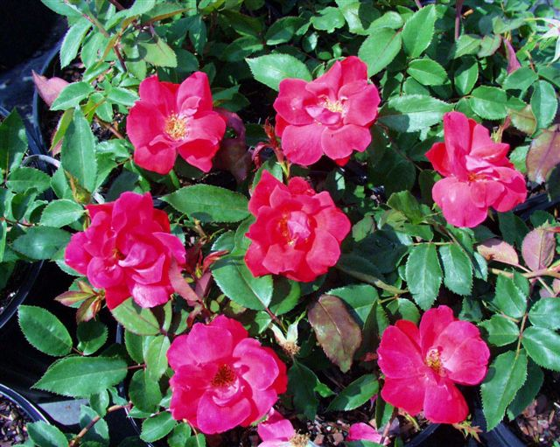
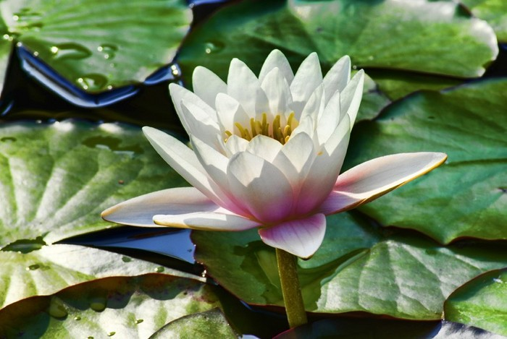
Producers
Producers get their energy from the sun. Producers are plants.

Slide 7
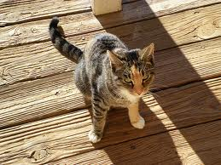
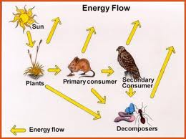
Consumers
An organism that eats other living things to get energy.

Slide 8
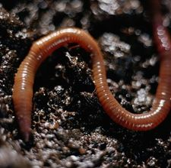
Decomposers
Is an organism that breaks down the remains of dead organisms.

Slide 9
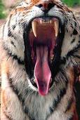
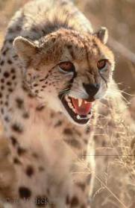
Carnivore
An animal that eats only other animals.

Slide 10
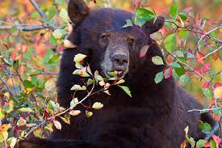
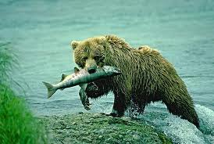
Omnivore
An animal that eats both plants and animals.

Slide 11
Herbivore

Slide 12
Food Chain
The path of food energy in an ecosystem as one thing eats another .

Slide 13
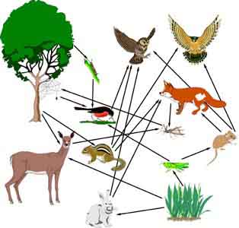
Food Web
Two or more food chains that overlap.

Slide 14
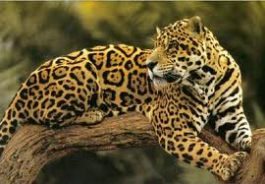
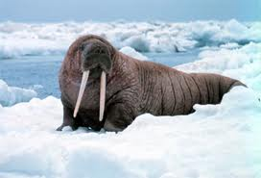
Examples of how organisms adapt for survival
Jaguar
Canine like teeth
Strong, short limbs
Lives in trees for months
Walrus
Thick blubber layer
Can go long periods without Oxygen

Slide 15
Summary
I learned that buffalo were once endangered.
I learned about photosynthesis.
I like the part about the carnivore, omnivore and herbivore.

