Slide 1
The Water Cycle
Dalton Cone
4th Grade

Slide 2
Water Cycle
Evaporation happens when liquid turns into water vapor.
Water vapor rises, cools and condenses into water droplets.
These droplets turn into clouds.
The drops become heavy and they fall to Earth as precipitation.
Some of the precipitation flows into streams, rivers and the ocean.

Slide 3
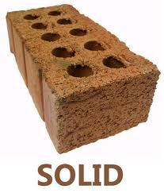
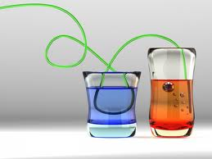
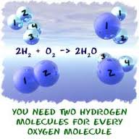
Solids, Liquids, and Gases
Solids
Liquids
Gases

Slide 4
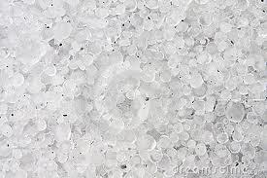
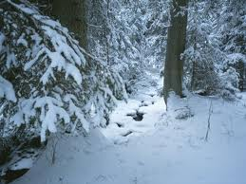
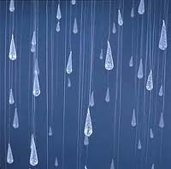
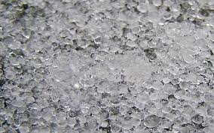
Forms of Precipitation
Hail
Snow
Rain
Sleet

Slide 5
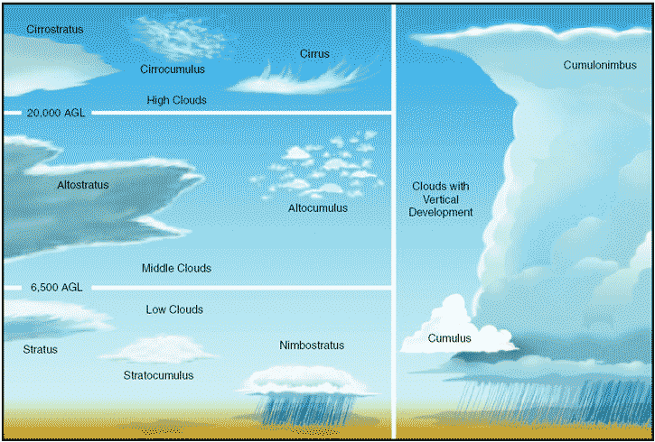
Formation Of Clouds
Happens when water condenses.

Slide 6
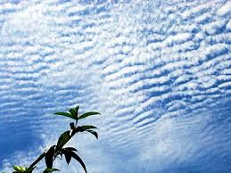
Stratus Clouds
Usually bring drizzling rain.
Form in many layers.
Low-level clouds.

Slide 7
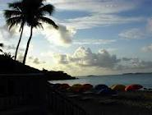
Cumulus Clouds
Usually brings fair weather.
Fluffy and are flat at the bottom.
Form low in the sky.

Slide 8
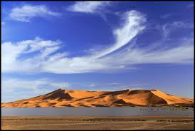
Cirrus Clouds
Made of ice crystals.
They are thin and look like feathers.
Always brings fair weather.

Slide 9
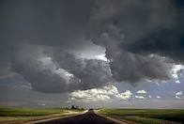
Cumulonimbus Clouds
Bring thunder storms.

Slide 10
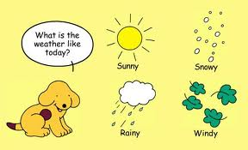
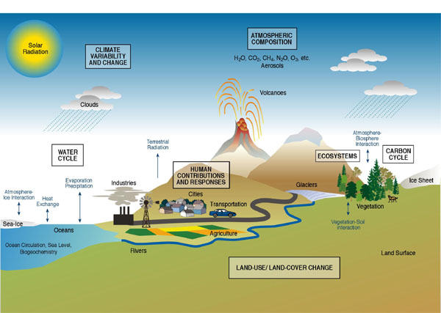
Difference between climate and weather
The climate is the average weather conditions in an area over a long period of time.
The weather is the conditions of the atmosphere at a certain place or time.

Slide 11
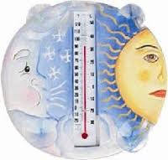
Thermometer
The thermometer measures temperature.

Slide 12
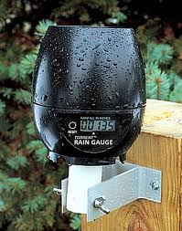
Rain Gauge
The rain gauge measures how much precipitation falls.

Slide 13
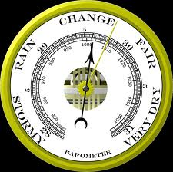
Barometer
The barometer measures air pressure.

Slide 14
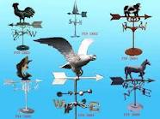
Wind Vane
The wind vane measures the direction of the wind.

Slide 15
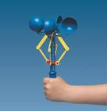
Anemometer
Measures wind speed

Slide 16
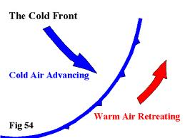
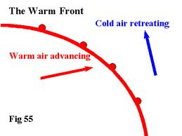
Cold Front versus Warm front
Cold Front:
Cold air mass meets warm air mass.
Cold air moves under the warm air,
pushing it up.
Moves down from Canada.
Warm Front:
Gray clouds and steady precipitation.
The warm air slowly moves up over the cold air.
A warm front forms as a warm air mass
pushes into a cold air mass.

Slide 17
Summary
I learned how clouds form and that tools measure weather and wind.
My favorite part was when we learned about precipitation.

