Slide 1
The Water Cycle
By
Baylen Bryan

Slide 2
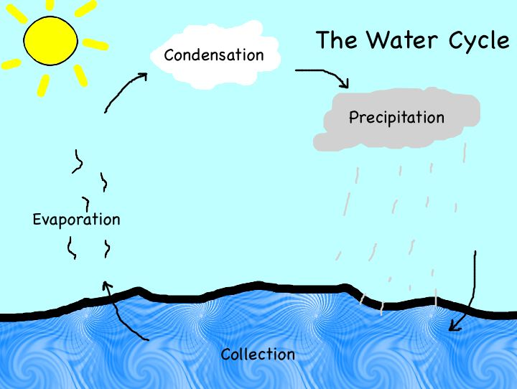
The Water Cycle
The movement of water into the air as water vapor and back to Earth’s surface as precipitation.

Slide 3
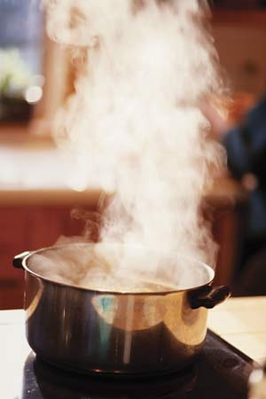
Evaporation
Heat from the sun can melt ice on a lake, river, or other solid ice surface and change it to a liquid. The sun can also change the liquid to water vapor.
Evaporation happens when a liquid changes to a gas.

Slide 4
Condensation
Condensation is when a gas changes to a liquid.
The gassy air cools and the water vapor condenses. It becomes a liquid again.

Slide 5
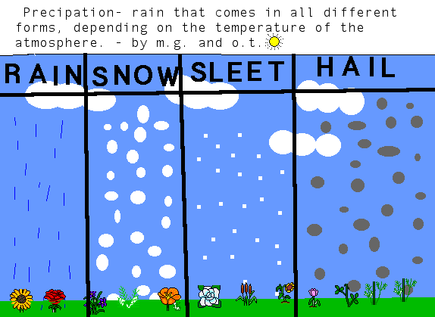
Precipitation
Any form of water that falls from the clouds to Earth.
The water vapor collects and gets really heavy that it begins to fall to Earth as precipitation.
The four forms are: Rain, Sleet, Snow, Hailstone

Slide 6
Solid
Matter that keeps its shape and size without a container.
Ice is the solid state of water.
It forms when heat is removed and temperatures fall below 0 degrees Celsius and 32 degrees Fahrenheit.

Slide 7
Liquid
Matter that takes the shape of its container and is pourable.
Water is a liquid.

Slide 8
Gas
Matter that takes the shape of its container with a lid. If the lid is taken off, the gas will go out into the air.
Water in a gas form is water vapor.

Slide 9
Causes of Cloud Formation
Clouds form when water vapor in the air condenses. Condensation is what makes the clouds form.

Slide 10
Stratus
Clouds that are low-level that form layers.
Stratus clouds usually bring rain.

Slide 11
Cumulus
These clouds are fluffy with a flat bottom.
They are found low in the sky.
Usually mean fair weather.

Slide 12
Cirrus
Thin clouds that look like feathers.
Made of ice crystals.
Found high in the sky.
Mean weather is fair.

Slide 13
Cumulonimbus
Clouds that bring thunderstorms!

Slide 14
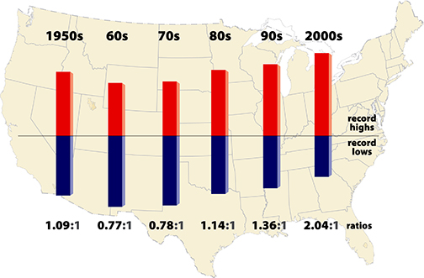
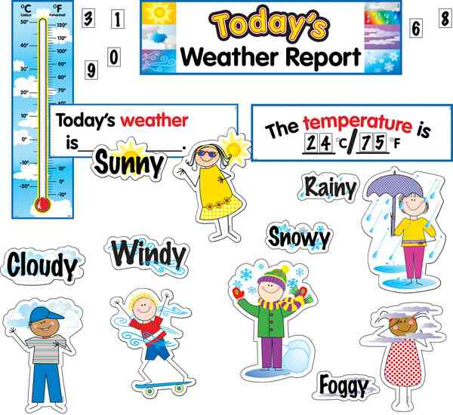
Compare Climate and Weather
Climate
Both
Weather
The average weather conditions in an area over a long period of time.
Both are conditions of the atmosphere and deal with weather
The conditions of the atmosphere at a certain place and time.

Slide 15
Thermometer
A thermometer measures the temperature of the air.
How hot or cold it is.

Slide 16
Rain Gauge
A rain gauge collects and measures the amount of precipitation that has fallen in an area.
How much rain a place gets.

Slide 17
Barometer
Measures air pressure

Slide 18
Wind Vane
Tells which direction the wind is blowing.
Example the wind is blowing Southeast.

Slide 19
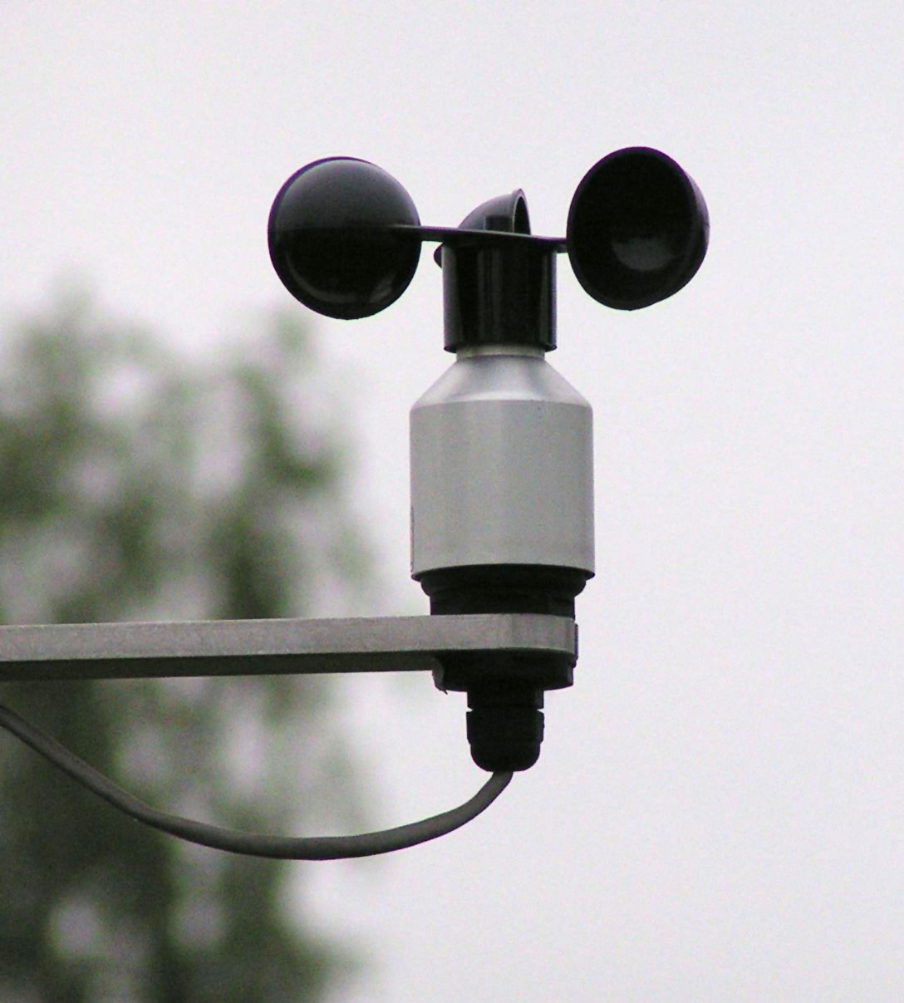
Anemometer
Measures the speed of the wind.
Example is 8 mile per hour wind.

Slide 20
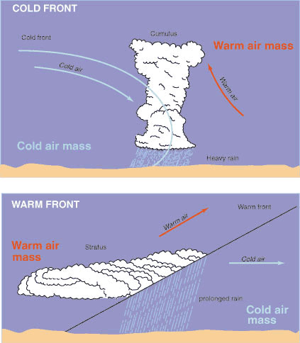
What are Cold & Warm Fronts?
Cold front
Warm front
A cold front forms as a cold air mass meets a warm air mass.
A warm front forms as a warm air mass pushes into a cold air mass.

Slide 21
What have I learned this period?!?
I learned about the water cycle and the weather tools, and how to use them. I also liked the balloon project☺ . My favorite part was learning about the weather tools!!!
GO SCIENCE!☺!☺!

